Slide 1
CREDIT EDA ASSIGNMENT
Submitted BY – Parikshit Malhi

Slide 2
PROBLEM STATEMENT Business Understanding: The loan providing companies find it hard to give loans to the people due to their insufficient or non-existent credit history. Because of that, some consumers use it to their advantage by becoming a defaulter. When the company receives a loan application, the company has to decide for loan approval based on the applicant’s profile. Two types of risks are associated with the bank’s decision: Risk-1: If the applicant is likely to repay the loan, then not approving the loan results in a loss of business to the company Risk-2: If the applicant is not likely to repay the loan, i.e. he/she is likely to default, then approving the loan may lead to a financial loss for the company. The information about the loan application at the time of applying for the loan contains two types of scenarios: The client with payment difficulties: He/she had late payment more than X days on at least one of the first Y instalments of the loan in our sample. All other cases: All other cases when the payment is paid on time. When a client applies for a loan, there are four types of decisions that could be taken by the client/company): Approved: The Company has approved loan Application Cancelled: The client cancelled the application sometime during approval. Either the client changed her/his mind about the loan or in some cases due to a higher risk of the client, he received worse pricing which he did not want.

Slide 3
Refused: The company had rejected the loan (because the client does not meet their requirements etc.). Unused offer: Loan has been cancelled by the client but at different stages of the process. Business Objectives: This case study aims to identify patterns which indicate if a client has difficulty paying their instalments which may be used for taking actions such as denying the loan, reducing the amount of loan, lending (to risky applicants) at a higher interest rate, etc. This will ensure that the consumers capable of repaying the loan are not rejected. Identification of such applicants using EDA is the aim of this case study. In other words, the company wants to understand the driving factors (or driver variables) behind loan default, i.e. the variables which are strong indicators of default. The company can utilise this knowledge for its portfolio and risk assessment. In this case study, EDA is used to understand how consumer attributes and loan attributes influence the tendency to default.

Slide 4
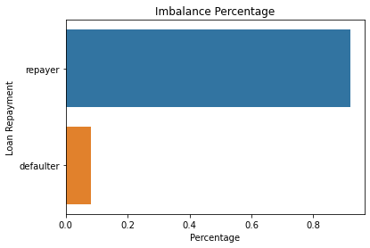
Univariate Analysis: The repayer percentage is 91.93% and the defaulter percentage is 8.07%.

Slide 5
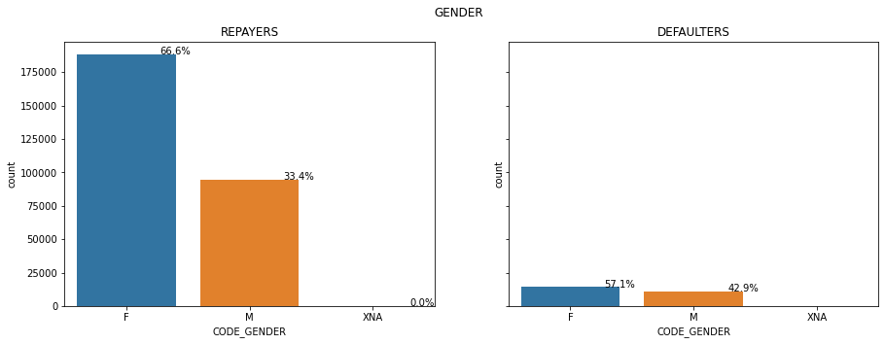
Observation: 1. Female defaulters are more than the male defaulters, this can be due to the greater number of female clients as compared to male clients. 2. Female clients have higher percentage (57.1%) of not repaying their loans, whereas male defaulters are 42.9%.

Slide 6
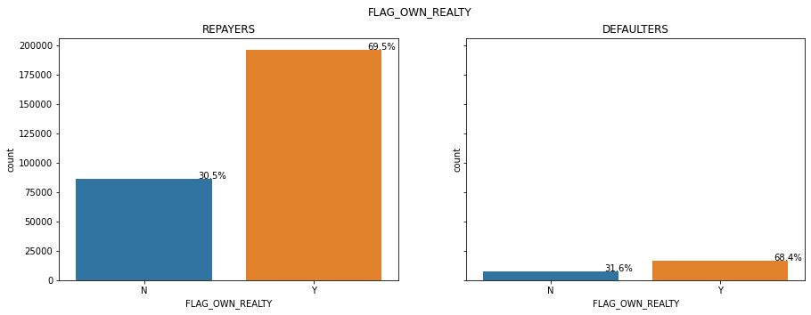
Observation: 1. In both the cases, clients who own the real estate are almost double than the clients who don't own a real estate. 2. In case of defaulters, the clients who own real estate (68.4%) are more likely to not pay their loans as compared to the clients who doesn't own a real estate (31.6%).

Slide 7
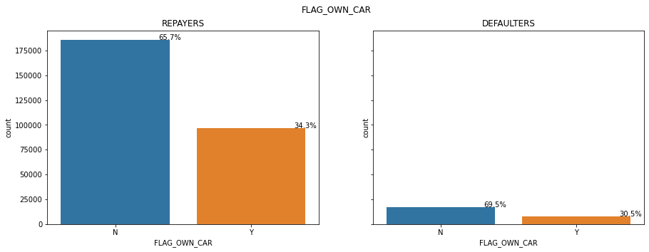
Observation: 1. In both the cases, clients who own a car are almost half than the clients who don't own a car. 2. In case of defaulters, the clients who don't own a car (69.5%) are more likely to not pay their loans as compared to the clients who own a car (30.5%).

Slide 8
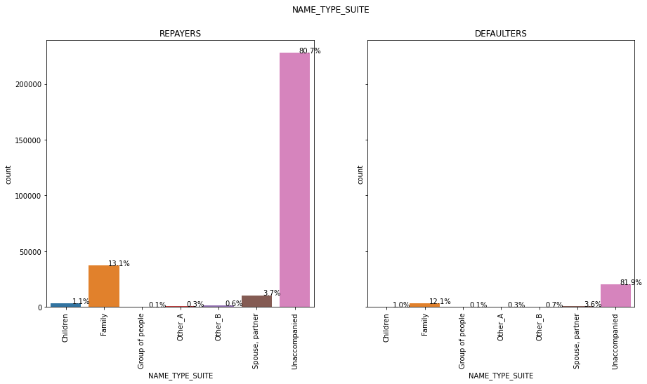
Observation: 1. According to the charts, among the repayers the highest percentage is of unaccompanied clients (80.7%) and among the defaulters, also the highest percentage is of unaccompanied clients (81.9%). 2. After the accompanied clients, the second highest percentages is of family among the repayers (13.1%) and defaulters (12.1%).

Slide 9
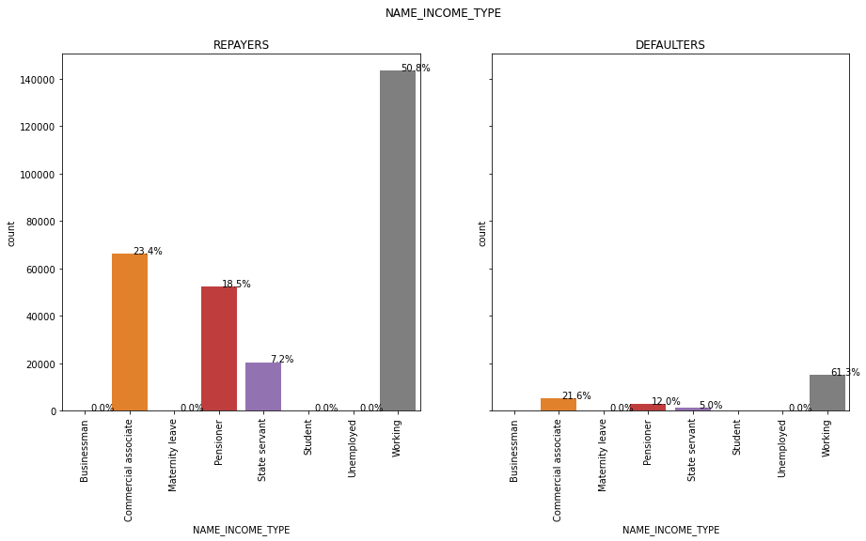
Observation: 1. Major clients taking loans are working professionals, and the are most likely to be defaulters (61.3%). 2. After the working professionals, commercial associates (21.6%) and pensioners (12%) are most likely to be defaulters.

Slide 10
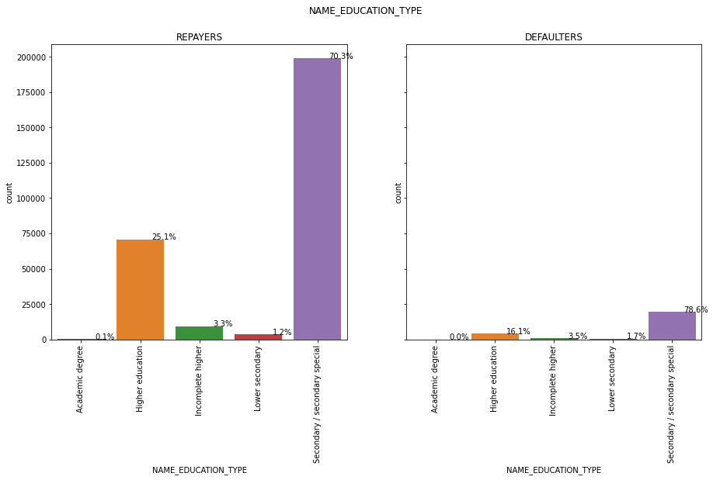
Observation: Clients having secondary education (78.6%), and higher education (16.1%) are most likely to be defaulters.

Slide 11
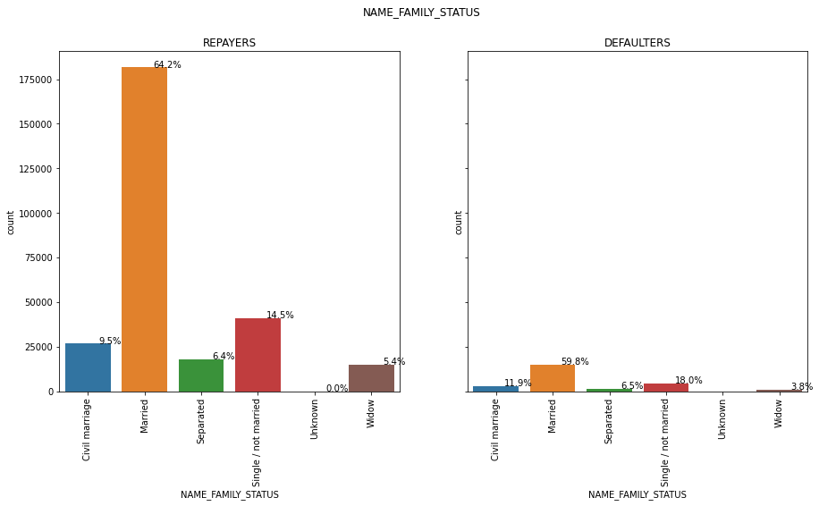
Observation: Married clients (59.8%) and single clients (18%) are most likely to be defaulters.

Slide 12
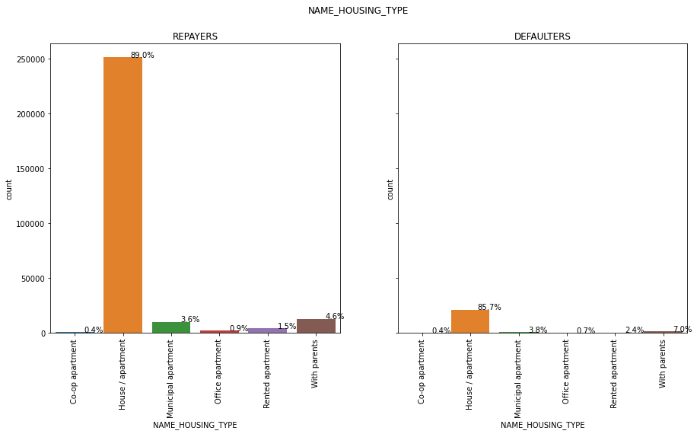
Observation: Clients living in house or apartments are most likely to be defaulters (85.7%)

Slide 13
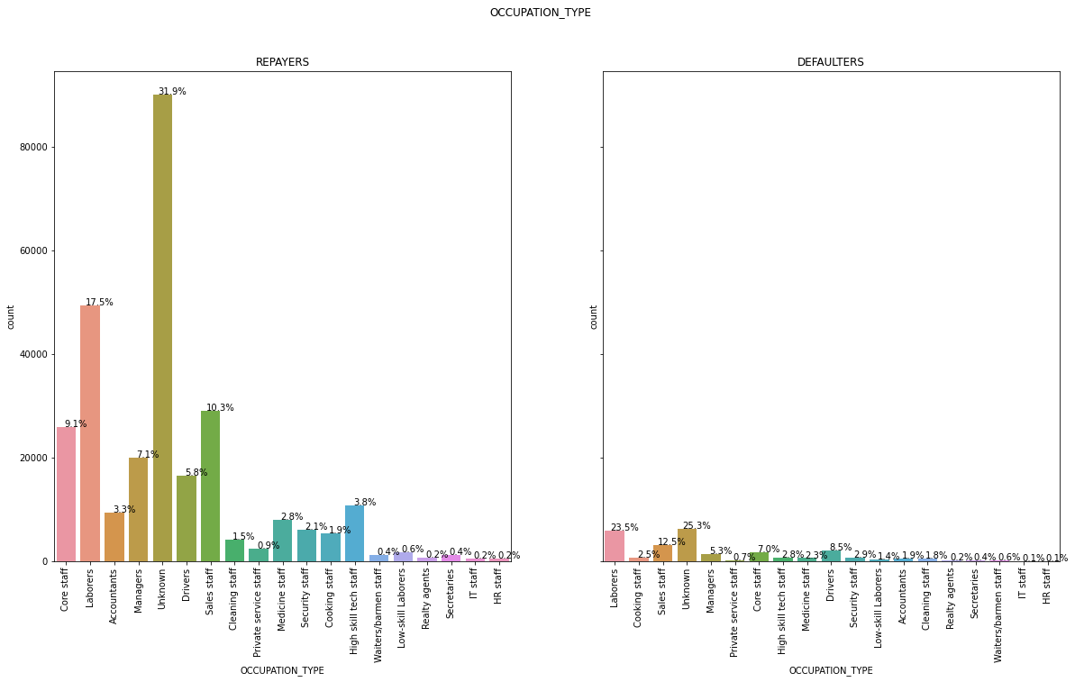
Observation: Unknown category is most lkely to be defaulter (25.3%). Next, labour clients are 23.3% defaulters, sales staff are 12.5% defaulters, and drivers are 8.5% defaulters.

Slide 14
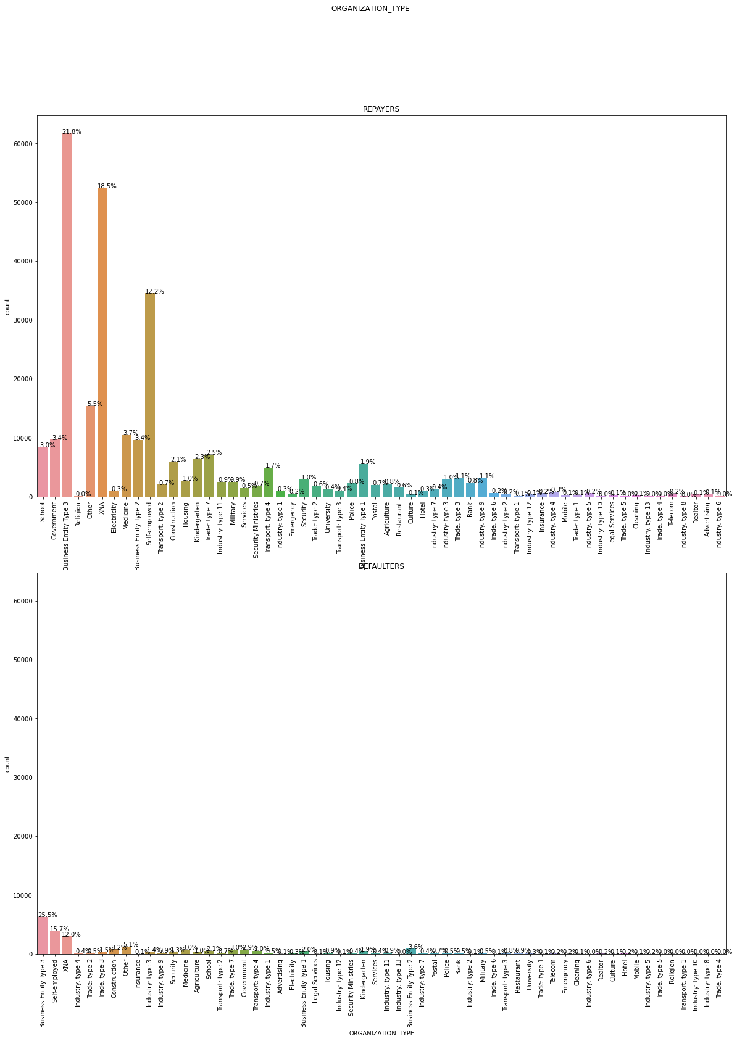
Observation: Unknown category is most lkely to be defaulter (25.3%). Next, labour clients are 23.3% defaulters, sales staff are 12.5% defaulters, and drivers are 8.5% defaulters.

Slide 15
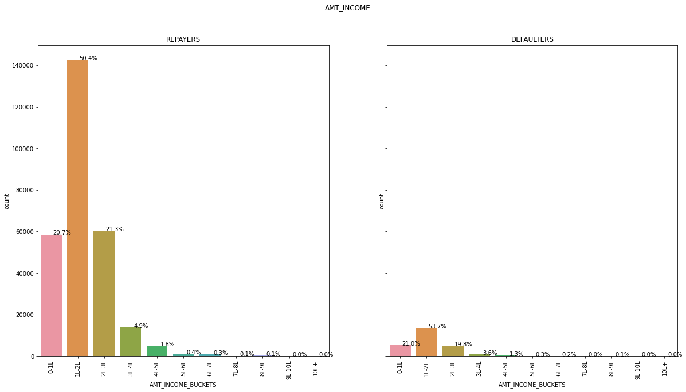
Observation: Clients with income in range 1-2L (53.7%), 0-1L (21%), and 2-3L (19.8%) are defaulters.

Slide 16
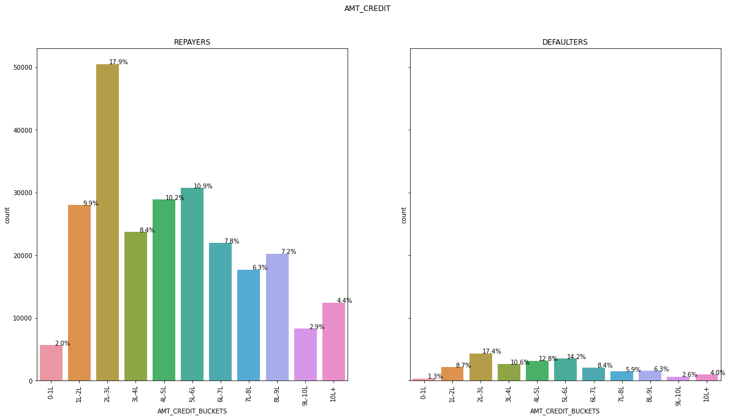
Observation: Clients with credit amount in range 2-3L (17.4%) and 5-6L (14.2%) are defaulters.

Slide 17
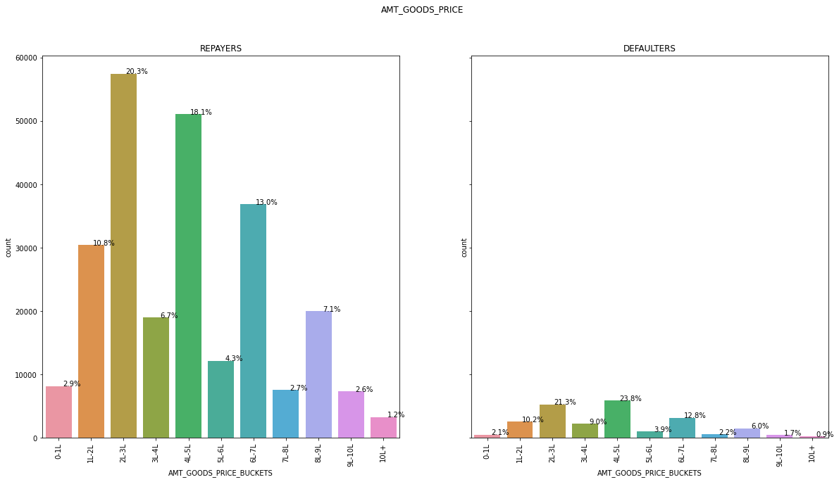
Observation: Clients taking loan against goods price 4-5L (23.8%) and 2-3L (21.3%) are defaulters.

Slide 18
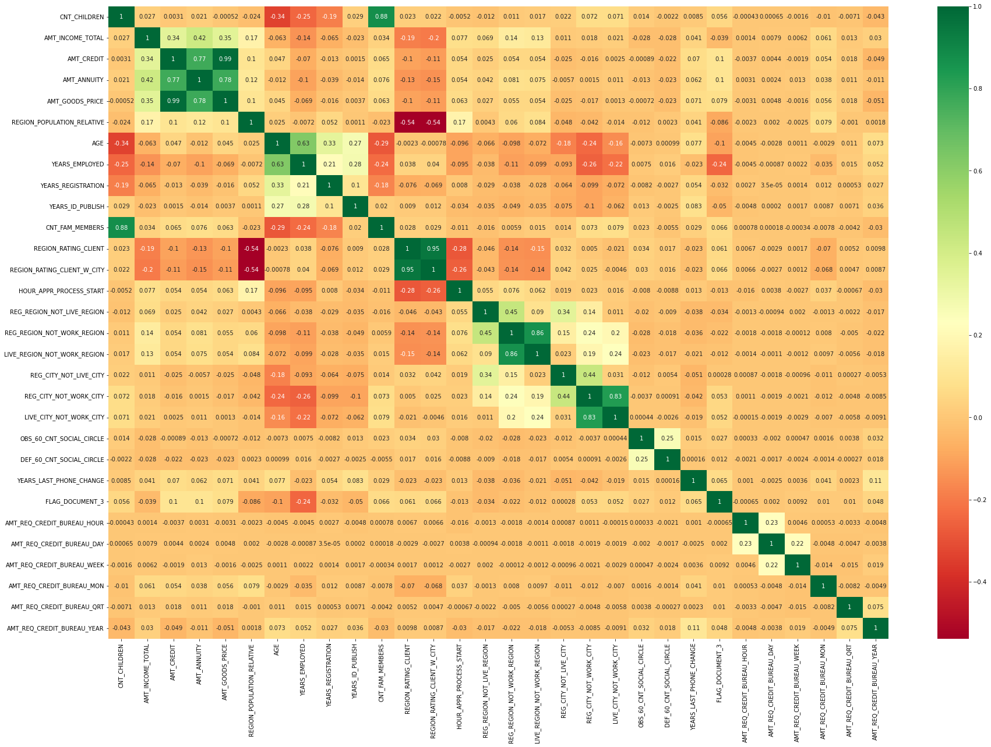
Observation: High correlations among repayers: 1. Goods price with credit amount 2. Loan annuity with credit amount 3. Loan annuity with goods price

Slide 19
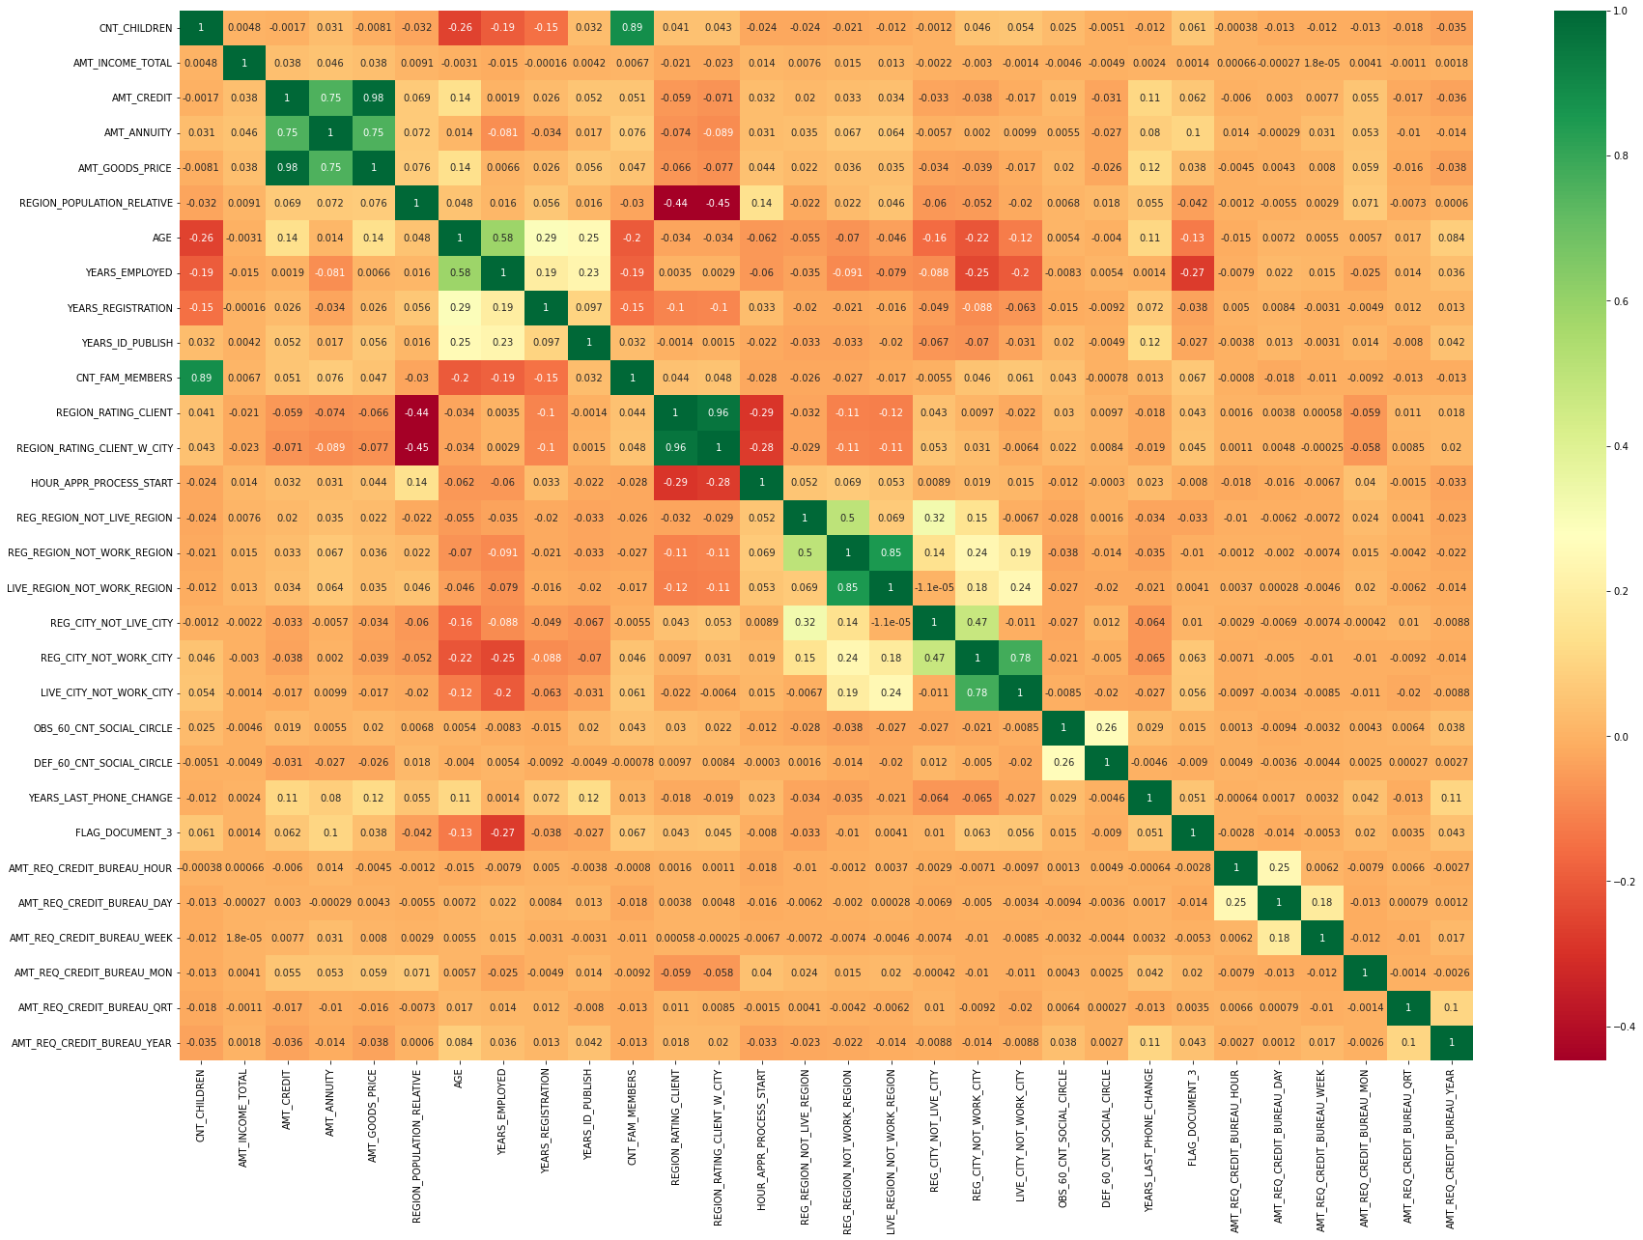
Observation: High correlations among repayers: 1. Goods price with credit amount 2. Loan annuity with credit amount 3. Loan annuity with goods price

Slide 20
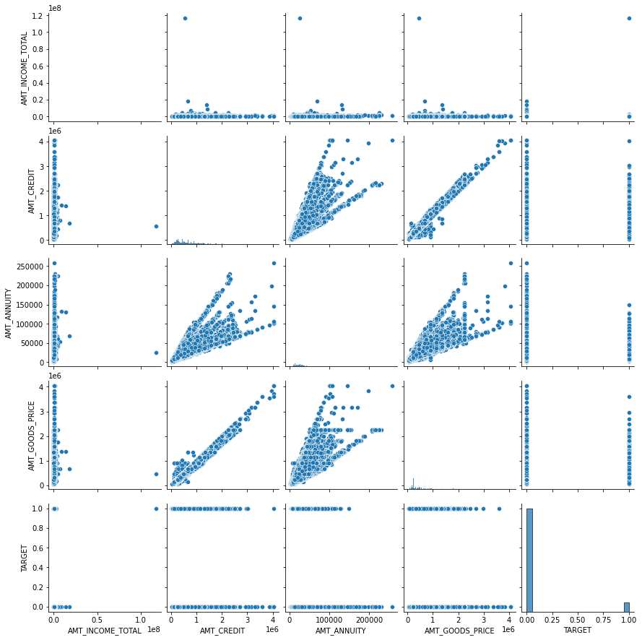
Observation: High linearity between credit amount and goods price.

Slide 21
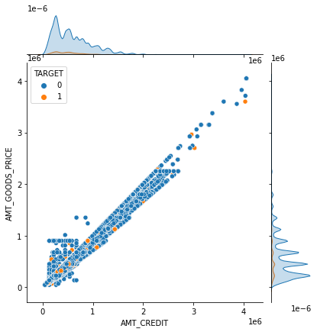
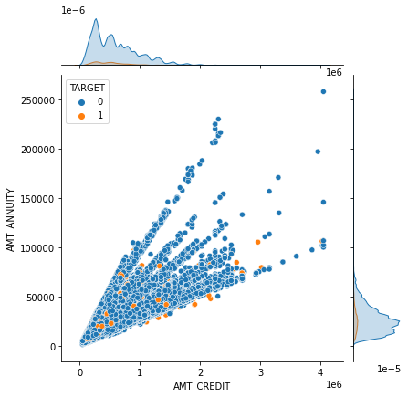
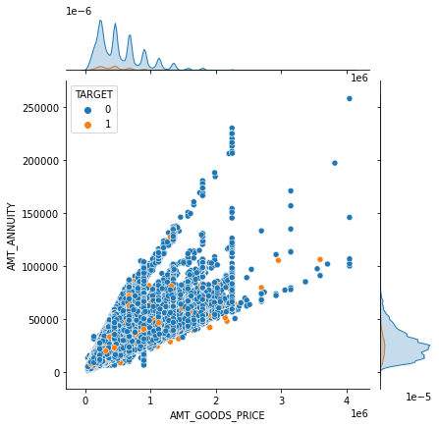
Observation: Most of the defaulters are with lower credit amount and lower goods price.
Observation: Most of the defaulters are with lower to medium credit amount and lower to medium loan annuity.
Observation: Most of the defaulters are with lower to medium goods price and lower to medium loan annuity.

Slide 22
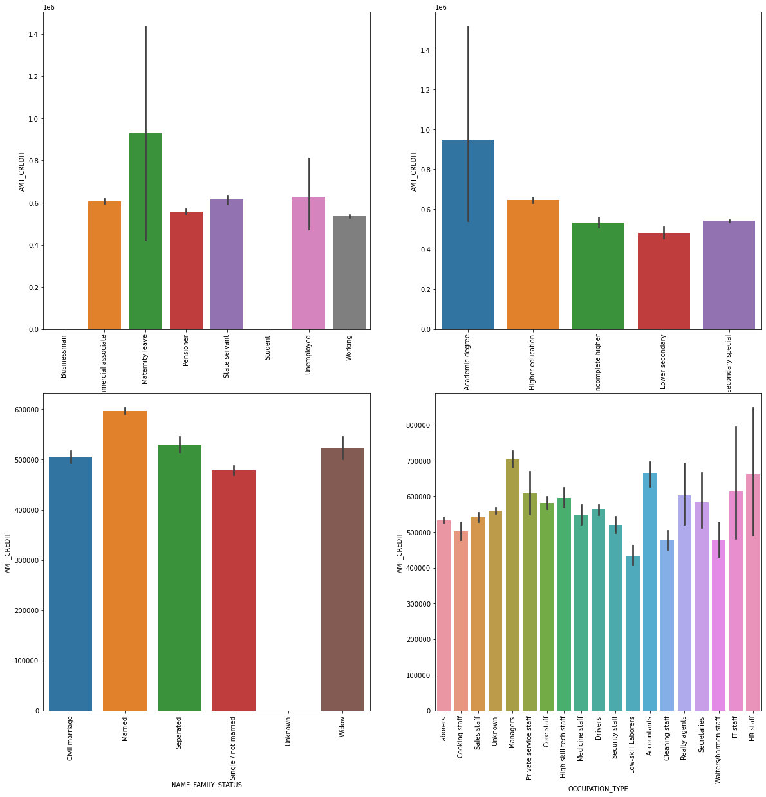
Observation: Credit amount variable is used for comparison. 1. Clients with maternity leave income type are the most defaulters. 2. Clients with academic degree are the most defaulters. 3. Married clients are the most defaulters. 4. Manager clients are the most defaulters.

Slide 23
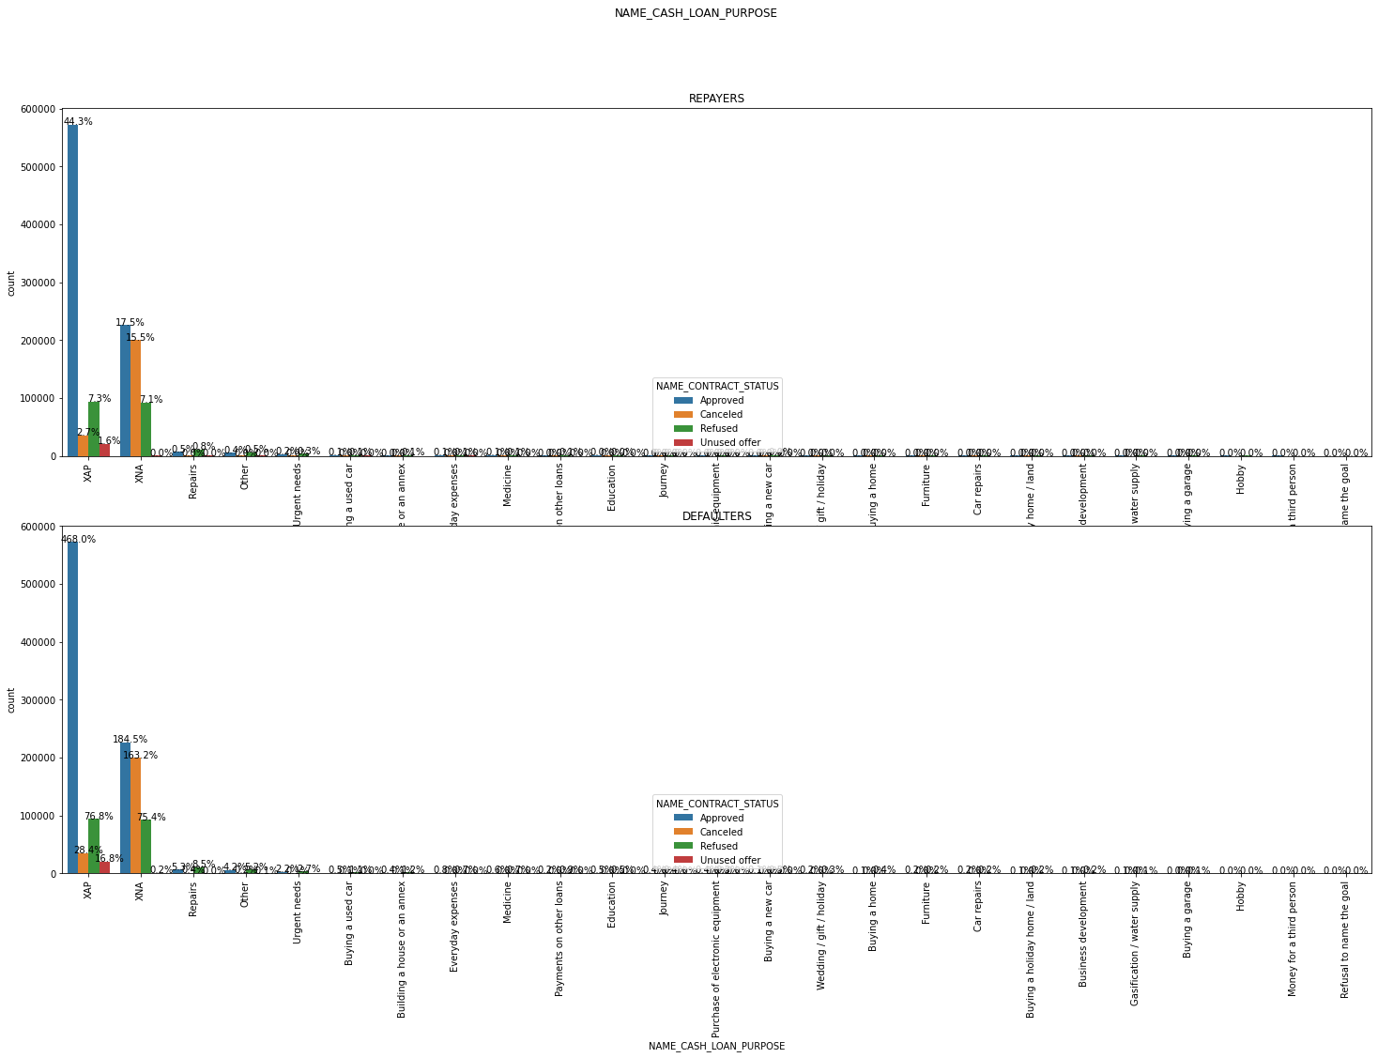
Observation: 1. XAP AND XNA values are unknown and in very high number as compared to other variables. 2. Bank has refused loan application for repairs (0.8%) and others (0.5%), and considered high risk by the banks.

Slide 24
Conclusions: 1. Low Risk group with less defaulters: a. Clients with maternity leave income type. b. Clients with academic degree are the most defaulters. c. Married clients are the most defaulters. d. Manager clients are the most defaulters. e. Most of the repayers are with lower credit amount and lower goods price. f. Clients taking loan against goods price 2-3L are repayers. g. Clients with credit amount in range 2-3L repayers. h. Clients with income in range 1-2L are repayers. i. Clients working in Business type 3 are most likely to be repayers. j. Labour clients are the most repayers. k. Clients having secondary education and higher education are most likely to be repayers. l. The working professionals are most likely to be repayers. m. The clients who own a car (69.5%) are more likely to pay their loans n. The clients who don’t own a real estate are more likely to pay their loans. o. Females are more likely to pay their loans.

Slide 25
2. High risk groups with more defaulters: a. Clients with maternity leave income type. b. Clients with academic degree are the most defaulters. c. Married clients are the most defaulters. d. Manager clients are the most defaulters. e. Most of the defaulters are with lower to medium goods price and lower to medium loan annuity. f. Most of the defaulters are with lower to medium credit amount and lower to medium loan annuity. g. Most of the defaulters are with lower credit amount and lower goods price. h. Clients taking loan against goods price 4-5L and 2-3L are defaulters. i. Clients with credit amount in range 2-3L and 5-6L are defaulters. j. Clients with income in range 1-2L, 0-1L, and 2-3L are defaulters. k. Clients working in Business type 3, self-employed, XNA are defaulters. l. Labour clients are 23.3% defaulters, sales staff are 12.5% defaulters, and drivers are 8.5% defaulters. m. Clients having secondary education, and higher education are most likely to be defaulters. n. The working professionals are most likely to be defaulters. o. The clients who don't own a car are more likely to not pay their loans. p. The clients who own a real estate are more likely to not pay their loans. q. Female are more likely to not pay their loans.

